Slide 1
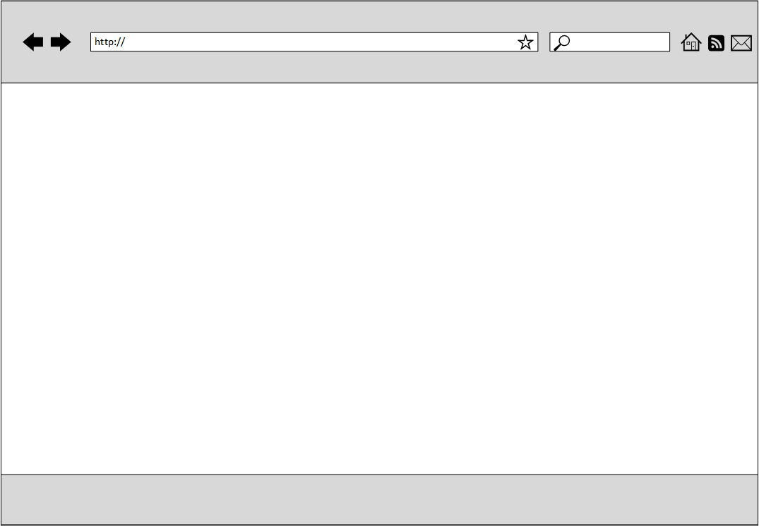
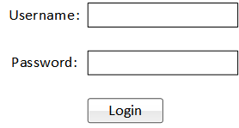

Slide 2
Bootsrap
Heatmap
Basic Location Report
Automatic Group Identification
Group –aware Location Report
SLOCA
Hello Admin
Welcome to SLOCA!!

Slide 3


Bootsrap
Heatmap
Basic Location Report
Automatic Group Identification
Group –aware Location Report
SLOCA

Slide 4
Heatmap
Basic Location Report
Automatic Group Identification
Group –aware Location Report
SLOCA
Hello (Username)
Welcome to SLOCA!!

Slide 5
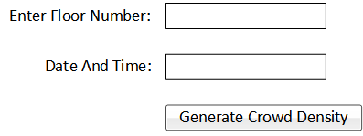
Heatmap
Basic Location Report
Automatic Group Identification
Group –aware Location Report
SLOCA
Appendix:
Crowd Density | Number of People per Semantic Place
0 | 0
1 | 1 to 2
2 | 3 to 5
3 | 6 to 10
4 | 11 to 20
5 | 21 to 30
6 | 30 and more

Slide 6

Heatmap
Basic Location Report
Automatic Group Identification
Group –aware Location Report
SLOCA
Appendix:
Crowd Density | Number of People per Semantic Place
0 | 0
1 | 1 to 2
2 | 3 to 5
3 | 6 to 10
4 | 11 to 20
5 | 21 to 30
6 | 30 and more
Crowd Density is
(Number)
for floor (Entered floor)
on (Date/Time)

Slide 7
Heatmap
Basic Location Report
Automatic Group Identification
Group –aware Location Report
SLOCA
Crowd Density for all semantic places
for floor (Entered floor)
on (Date/Time)
Appendix:
Crowd Density | Number of People per Semantic Place
0 | 0
1 | 1 to 2
2 | 3 to 5
3 | 6 to 10
4 | 11 to 20
5 | 21 to 30
6 | 30 and more
UI for this part to be decided later

Slide 8




Heatmap
Basic Location Report
Automatic Group Identification
Group –aware Location Report
SLOCA

Slide 9
Heatmap
Basic Location Report
Automatic Group Identification
Group –aware Location Report
SLOCA
Breakdown by Year and Gender
YEAR | TOTAL MATCHES | %
GENDER | TOTAL MATCHES | %
SCHOOL | TOTAL MATCHES | %

Slide 10


Heatmap
Basic Location Report
Automatic Group Identification
Group –aware Location Report
SLOCA
Top k popular places
Rank | Popular Places
1
…
k

Slide 11

Heatmap
Basic Location Report
Automatic Group Identification
Group –aware Location Report
SLOCA
Top-k companions
Rank | Companions | Time | Email
1…
k

Slide 12

Heatmap
Basic Location Report
Automatic Group Identification
Group –aware Location Report
SLOCA
Top-k next places
Rank | Next Place | No. of Users | %
1…
k

